Slide 1
graphic Design
Mata Kuliah IMK Kelas C & E

Slide 2
Agenda
The Role of Graphic Design
Principles of Graphic Design
Animation/Rollovers
Typography
Color
Icons

Slide 3
Graphic Design
The Role
Principles
Animation/Rollovers
Typography
Color
Icons
The “look & feel”
The system of imagery
It shares aspects of engineering, but with aesthetic, communicative aspects and consumer appeal.

Slide 4
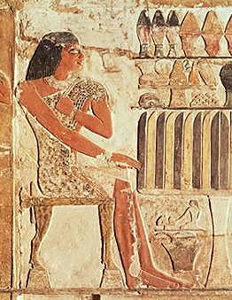
Graphic Design
The Role
Principles
Animation/Rollovers
Typography
Color
Icons
As a practice, it has been around for thousands of years.

Slide 5
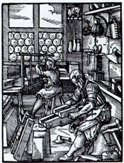
Graphic Design
The Role
Principles
Animation/Rollovers
Typography
Color
Icons
With the industrial revolution, art and design began to diverge.

Slide 6
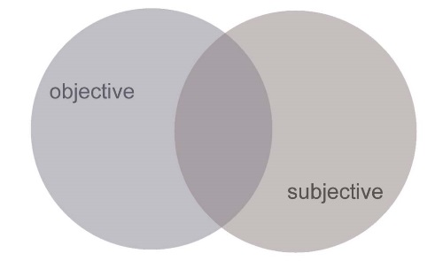
Graphic Design
The Role
Principles
Animation/Rollovers
Typography
Color
Icons
It relies on a BALANCE and integration of:
Objective: relies on quantitative studies, like usability and legibility measures. Does the “look and feel” work?
Subjective: “look and feel”
relies on subjective judgement by experts, depends on contextual factors.

Slide 7
Graphic Design
The Role
Principles
Animation/Rollovers
Typography
Color
Icons
It relies on a BALANCE and integration of:
Objective: relies on quantitative studies, like usability and legibility measures. Does the “look and feel” work?
Subjective: “look and feel”
Culture is learned, cultural meanings change, meanings can be multiple. Uniqueness is valued (not programmable).

Slide 8
Graphic Design
The Role
Principles
Animation/Rollovers
Typography
Color
Icons
It relies on a BALANCE and integration of:
Objective: relies on quantitative studies, like usability and legibility measures. Does the “look and feel” work?
Subjective: “look and feel”
You cannot empirically measure its subjective aspects, but it is rigorous in its own epistemological realm (knowledge base).

Slide 9
Graphic Design
The Role
Principles
Animation/Rollovers
Typography
Color
Icons
It relies on a BALANCE and integration of:
Objective: relies on quantitative studies, like usability and legibility measures. Does the “look and feel” work?
Subjective: “look and feel”
1. Graphic Design experts. vs.
2. Deploying graphic design principles (anybody).

Slide 10
Graphic Design
The Role
Principles
Animation/Rollovers
Typography
Color
Icons
It relies on a BALANCE and integration of:
Objective: relies on quantitative studies, like usability and legibility measures. Does the “look and feel” work?
Subjective: “look and feel”
Deploying graphic design principles will:
- enhance your ability to communicate with designers

Slide 11
Graphic Design
The Role
Principles
Animation/Rollovers
Typography
Color
Icons
It relies on a BALANCE and integration of:
Objective: relies on quantitative studies, like usability and legibility measures. Does the “look and feel” work?
Subjective: “look and feel”
Deploying graphic design principles will:
- enable you to create more user-friendly interfaces

Slide 12
Graphic Design
The Role
Principles
Animation/Rollovers
Typography
Color
Icons
It relies on a BALANCE and integration of:
Objective: relies on quantitative studies, like usability and legibility measures. Does the “look and feel” work?
Subjective: “look and feel”
Deploying graphic design principles will:
- enhance the knowledge base of HCI, which is increasingly necessary with millions of users

Slide 13
Role of Graphic Design
The Role
Principles
Animation/Rollovers
Typography
Color
Icons
The “look and feel” portion of an interface:
What someone initially encounters
Sets a framework for understanding content
Conveys an impression, mood

Slide 14
Principles of Graphic Design
The Role
Principles
Animation/Rollovers
Typography
Color
Icons
Concept/Metaphor
Hierarchy
Clarity
Consistency
Alignment
Proximity
Contrast

Slide 15
Principles: Concept/Metaphor
The Role
Principles
Animation/Rollovers
Typography
Color
Icons
Concept: what is the overarching idea that every visual aspect of the interface relates to? (It MUST be relevant)
Metaphor: (Means of “explaining” concept) If you’re building an interface for a grocery application, maybe mimic a person walking through a store with a cart.

Slide 16
Principles: Hierarchy
The Role
Principles
Animation/Rollovers
Typography
Color
Icons
What are the relative “levels” of importance?
What should the user see first? Second?

Slide 17
Principles: Clarity
The Role
Principles
Animation/Rollovers
Typography
Color
Icons
Every element in an interface should have a reason for being there
Make that reason clear!
Less is more

Slide 18
Principles: Clarity
The Role
Principles
Animation/Rollovers
Typography
Color
Icons
White space
Leads the eye
Provides symmetry and balance through its use
Strengthens impact of message
Allows eye to rest between elements of activity (increases legibility)
Used to promote simplicity, elegance, refinement

Slide 19
Principles: Consistency
The Role
Principles
Animation/Rollovers
Typography
Color
Icons
Be consistent in every aspect:
In layout, color, images, icons, typography, text
Within screen, across screens
Stay within metaphor everywhere
Platform may have a style guide -- follow it!

Slide 20
Principles: Alignment
The Role
Principles
Animation/Rollovers
Typography
Color
Icons
Western world
Start from top left
Allows eye to parse display more easily

Slide 21
Principles: Alignment
The Role
Principles
Animation/Rollovers
Typography
Color
Icons
Grids
(Hidden) horizontal and vertical lines to help locate window components
Align related things
Group items logically
Minimize number of controls, reduce clutter

Slide 22
Principles: Alignment
The Role
Principles
Animation/Rollovers
Typography
Color
Icons
Grids – use them

Slide 23
Principles: Alignment
The Role
Principles
Animation/Rollovers
Typography
Color
Icons
Left, center, or right
Ragged right or justified
Justiﬁcation without hyphenation slows reading due to gaps between words.
Use either ﬂush left, or justiﬁed with hyphenation.
Choose one, use it everywhere
Novices often center things
Hard to read!
No definition, calm, very formal
Use only in small quantities

Slide 24
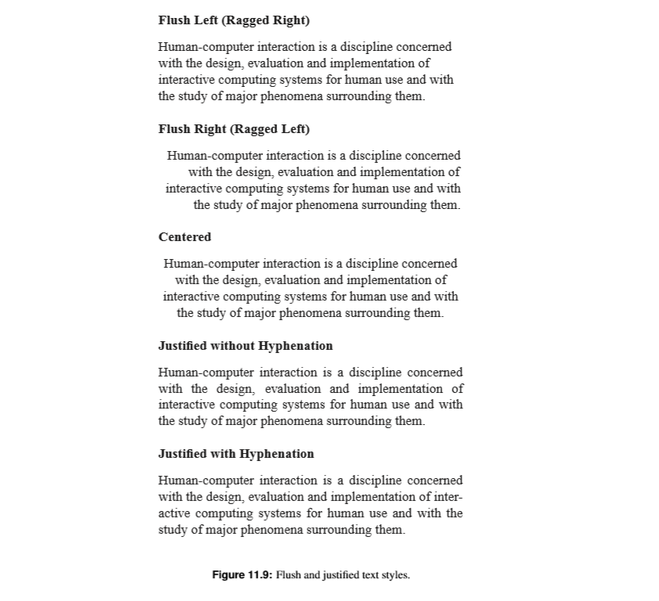
Principles: Alignment
The Role
Principles
Animation/Rollovers
Typography
Color
Icons

Slide 25
Principles: Proximity
The Role
Principles
Animation/Rollovers
Typography
Color
Icons
Items close together appear to have a relationship
Large distance implies -- no relationship

Slide 26
Principles: Contrast
The Role
Principles
Animation/Rollovers
Typography
Color
Icons
Pulls you in
Guides your eyes around the interface
Supports skimming
Take advantage of contrast to guide user through hierarchy of information; add focus; or to energize an interface with “texture”
Can be used to distinguish active control

Slide 27
Principles: Contrast
The Role
Principles
Animation/Rollovers
Typography
Color
Icons
Can be used to set off most important item
Allow it to dominate
Ask yourself what is the most important item in the interface, highlight it
Use geometry to help sequencing

Slide 28
Animation/Rollovers
The Role
Principles
Animation/Rollovers
Typography
Color
Icons
Blinking
Good for grabbing attention, but easily becomes obnoxious; use very sparingly

Slide 29
Typography: Hierarchy
The Role
Principles
Animation/Rollovers
Typography
Color
Icons
How do you lead the user through visual information (by visual means)?
Some traditional navigation devices (conventions):
Size
Color
Composition (where it is on the rectangle)
Page numbers
Type and Image emphases

Slide 30
Factors Inﬂuencing the Legibility of Text
The Role
Principles
Animation/Rollovers
Typography
Color
Icons
Characters and symbols should be easily noticeable and distinguishable
AVOID HEAVY USE OF ALL UPPERCASE
Studies have found that: mixed case promotes fastest reading and that 55 characters per line is optimal

Slide 31
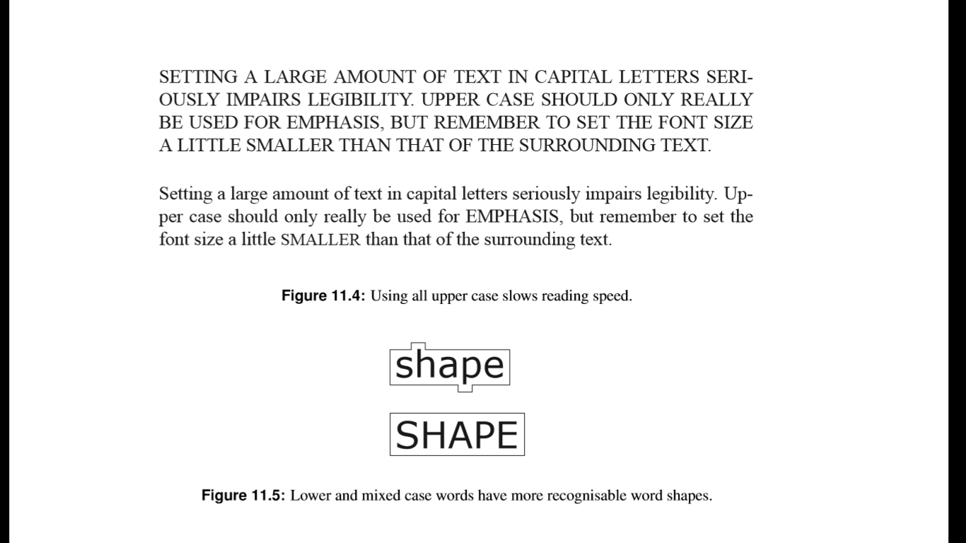
Factors Inﬂuencing the Legibility of Text
The Role
Principles
Animation/Rollovers
Typography
Color
Icons

Slide 32
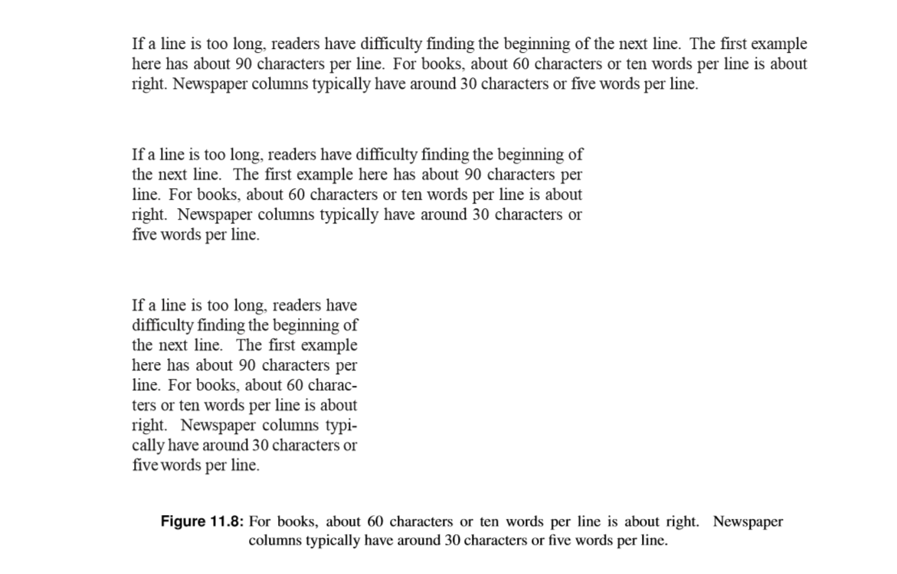
Factors Inﬂuencing the Legibility of Text
The Role
Principles
Animation/Rollovers
Typography
Color
Icons

Slide 33
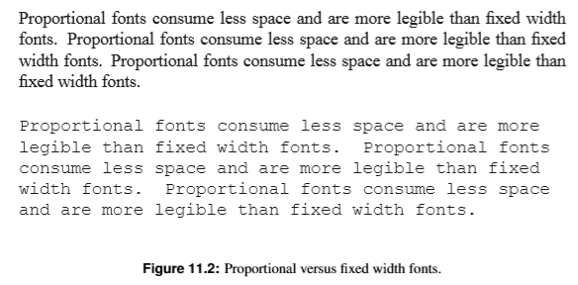
Factors Inﬂuencing the Legibility of Text
The Role
Principles
Animation/Rollovers
Typography
Color
Icons
Font Type
Proportional fonts consume less space and are more legible than ﬁxed width fonts.

Slide 34
Factors Inﬂuencing the Legibility of Text
The Role
Principles
Animation/Rollovers
Typography
Color
Icons
Font Size
10 pt is legible, 11 pt or 12 pt is better.
The distinction between font sizes should be at least 2 pt. [smaller changes cannot be discriminated by the eye]
For example, use:
12 pt for ﬂowing text
10 pt for subscripts and footnotes
14 pt for section headings
16 pt or larger for titles

Slide 35
Factors Inﬂuencing the Legibility of Text
The Role
Principles
Animation/Rollovers
Typography
Color
Icons
Character, Word, and Line Spacing
Character spacing depends largely on font.
Word spacing ≈ width of an ‘n’.
Line spacing ≈ 2 pt.

Slide 36
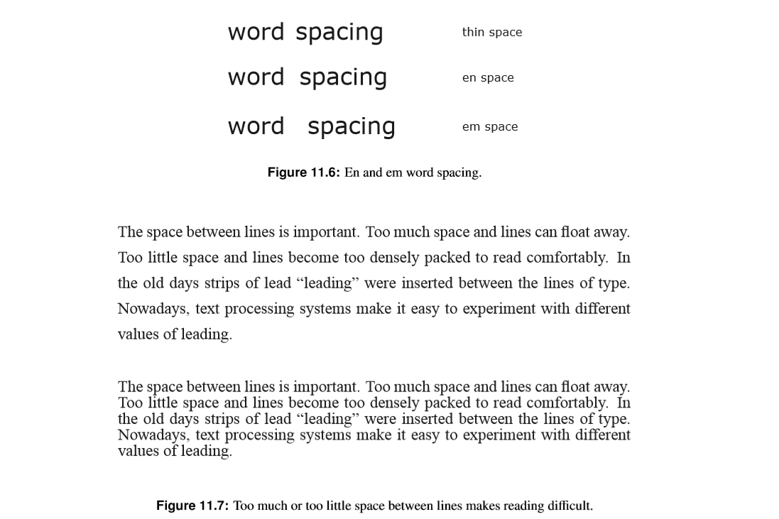
Factors Inﬂuencing the Legibility of Text
The Role
Principles
Animation/Rollovers
Typography
Color
Icons

Slide 37
Factors Inﬂuencing the Legibility of Text
The Role
Principles
Animation/Rollovers
Typography
Color
Icons
Overall Text Environment
Maximum of:
two typefaces,
two slants (normal, italic),
two weights (medium, bold),
and four sizes (title, subtitle, text, footnote)

Slide 38
Color Attribute
The Role
Principles
Animation/Rollovers
Typography
Color
Icons
Hue
native color, pigment
Saturation
relative purity, brightness, or intensity of a color
Value
lightness or darkness of a color

Slide 39
Color
The Role
Principles
Animation/Rollovers
Typography
Color
Icons
Use it for a purpose, not to just add some color in
Color Guidelines
Use color sparingly--Design in b/w then add color where appropriate
Use color to draw attention, communicate organization, to indicate status, to establish relationships
Avoid using color in non-task related ways

Slide 40
How many small rectangles

Slide 41
How many small rectangles

Slide 42
How many small ovals

Slide 43
How many small ovals

Slide 44
Find the R

Slide 45
Find the...
V
C
M
R
G
T
Q
D
P
F
A
Z
W
J

Slide 46
Find the T

Slide 47
Find the...
V
C
M
R
G
T
Q
D
P
F
A
Z
W
J

Slide 48
Color
The Role
Principles
Animation/Rollovers
Typography
Color
Icons
Color Guidelines
Color is good for supporting search
Do not use color without another redundant cue
Color-blindness
Monochrome monitors
Redundant coding enhances performance
Be consistent with color associations from jobs and cultures

Slide 49
Color
The Role
Principles
Animation/Rollovers
Typography
Color
Icons
Color Guidelines
Limit coding to 8 distinct colors (4 better)
Avoid using saturated blues for text or small, thin lines
Use color on b/w or gray, or b/w on color
To express difference, use high contrast colors (and vice versa)
Make sure colors do not “vibrate”

Slide 50
Color Associations
Culturally specific, contextually specific
Red
hot, warning,
aggression, love
Pink
female, cute, cotton candy
Orange
autumn, warm, Halloween, Cell phone
Yellow
happy, caution, joy
Brown
warm, fall, dirt, earth
Green
lush, pastoral, envy
Purple
royal, sophisticated, Barney

Slide 51
Color Palettes/Suites
Designers often pick a palette of 4 or 5 colors
Variations of 2 colors
Monochromatic (variations of 1 color)
Southwestern (culturally evocative)

Slide 52
Icon Design
The Role
Principles
Animation/Rollovers
Typography
Color
Icons
Relies on drawing ability -- hire someone to do it
(here are standards and ways to critique icon design)
Avoid meaningless, gratuitous use of icons
Too many icons quickly become illegible

Slide 53
Icon Design
The Role
Principles
Animation/Rollovers
Typography
Color
Icons
Represent object or action in a familiar and recognizable manner
Limit number of different icons
Make icon stand out from background
Ensure that a singly selected icon is clearly visible when surrounded by unselected ones

Slide 54
Icon Design
The Role
Principles
Animation/Rollovers
Typography
Color
Icons
Make each icon distinctive (legible)
but
Make icons harmonious members of icon family
Avoid excessive detail
Accompany with names
(though it shouldn’t be necessary)

Slide 55
Review: Rancangan Pembelajaran IMK (dosen: AY)
 |  | w1 | w2 | w3 | w4 | w5 | w6 | w7 | w8 | w9 | w10 | w11 | w12 | w13 | w14 | w15 | w16
1 | a. Mahasiswa mampu mendiskusikan mengapa pengembangan perangkat lunak yang berpusat pada pengguna itu penting. | Human Computer Interaction [C1]; The Psychology of Usable Things [C2] | The Psychology of Usable Things [C2] |  |  |  |  |  |  |  |  |  |  |  |  | A Brief History of HCI [C13]
2 | b. Mahasiswa mampu memahami aturan/pedoman dasar dalam pengembangan perangkat lunak berikut desain interaksinya dengan mempertimbangkan aspek fisik, psikologi dan sosial pengguna. |  |  | Usability Engineering [C3]; Know the User [C4]
3 | c. Mahasiswa mampu mengembangkan dan menggunakan konsep permodelan, umpan balik untuk menganalisa interaksi antara manusia dengan perangkat lunak. |  |  |  | Usability Benchmarking [C5]; Quiz1
4 | d. Mahasiswa mampu mendefinisikan proses desain yang berfokus pada pengguna yang secara eksplisit menempatkan pengguna bukan sebagai pembangun. |  |  |  |  | Goal-Oriented Interaction Design [C6] | Goal-Oriented Interaction Design [C6] |  |  |  |  |  |  | Visual Design and Typography [C11] | Icon Design [C12]
5 | e. Mahasiswa mampu membangun aplikasi sederhana beserta petunjuk penggunaan, serta dokumentasinya yang mendukung antar muka pengguna. |  |  |  |  |  | Prototyping [C7] | Prototyping [C7]
6 | f. Mahasiswa mampu membuat dan melakukan tes ketepatgunaan (Usability Test) pada perangkat lunak yang telah dikembangkan, melakukan evaluasi secara kuantitatif (utilitas, efisiensi, tingkat kemudahan penggunaan, dan tingkat kepuasan pengguna), dan melaporkannya. |  |  |  |  |  |  |  |  | Usability Inspection Methods [C8] | Usability Testing Methods [C9] | Usability in Practice [C10]
7 | g. Mahasiswa mampu melaporkan dan mendiskusikan perkembangan teknologi interaksi natural (Natural User Interface) termutakhir: antarmuka sentuh (Multi-touch), antarmuka gerakan (Gesture), antarmuka gelombang otak (Electroencephalography), antarmuka gelombang otot (Electromyography).

